Slide 1

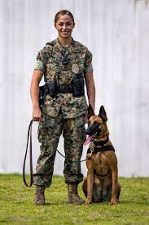
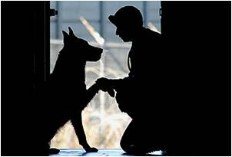
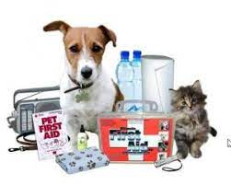

U.S. Army Naples
Veterinary Treatment Facility
OIC: CPT Paulynne Bellen
Clinic NCOIC: SGT James Watson

Slide 2
General information
Hours of operation
  Mon/Tues/Wed/Fri 0900-1230 and 1330-1600
  (except Holidays or no veterinarian available)
  Closed every THURSDAY (military training) and last working day of the month for inventory
Priorities:
  Military Working Dogs
  PCS related appointments
  Mandated vaccinations and preventives
Sick Calls can be seen based on limited availability and capability.
For dire illness or emergencies, please seek off post care. Refer to our local veterinarians list provided.

Slide 3
missionS
  Order of priority:
  Military Working Dogs (MWDs) health and readiness is our TOP MISSION
  Food safety and defense (Commissary; 39 food facilities inspections, food recalls)
  3. Public health protection (Rabies and zoonotic disease surveillance)
  4. Family readiness (Human animal bond and care of pets)

Slide 4
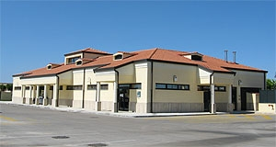
ELIGIBILITY
Active duty personnel
Retirees
GS employees
DoD civilian employees
A current military I.D./dependent I.D. is required during registration

Slide 5
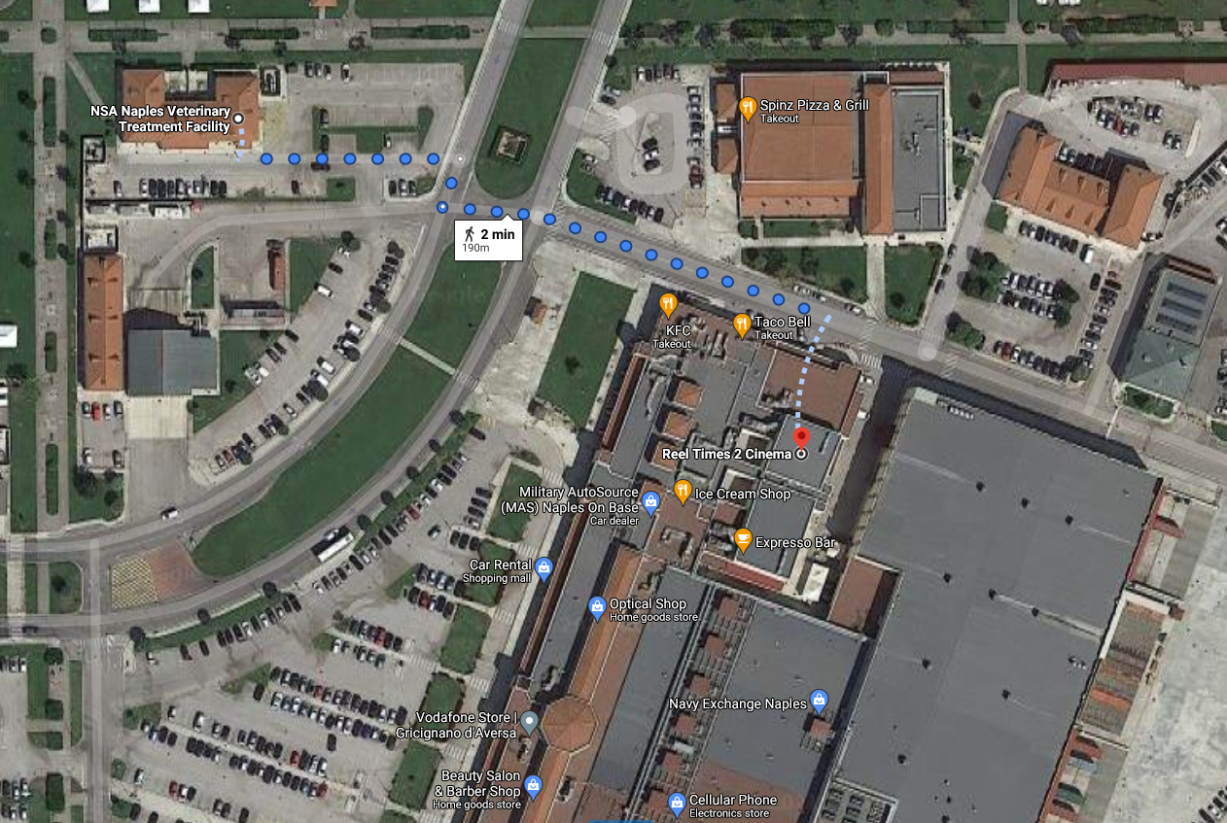
BASE MAP

Slide 6
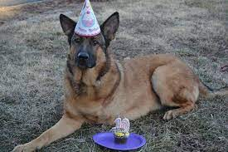
Pet Policy
Base Requirements and Pet Policy (Instruction 10570.2H)
All pets must be registered at the Naples Veterinary Treatment Facility (VTF) within 30 days of arrival or adoption. Every pet must have an ISO compliant microchip (15 digit) and a valid rabies vaccine. You need be registered in order to avail of our services.
All pets must wear Pet Identification Tag,
  Rabies tag, and NSA Naples Pet Pass tag.
Only 2 pets are authorized per owner in a
  government housing. (NO weight restrictions)

Slide 7
REGISTRATION
No appointment needed & pet does not need to be present.
Registration forms included in the AO packet can be picked up in person or via email request
Submit completed forms with requirements in person or via email to:
usn.naples.navhospnaplesit.mbx.vet-clinic@mail.mil.
Things to submit:
  Completed registration form including NO Show Policy
  Military I.D.
  Vaccine history
  Medical documentation of chronic disease
  All active prescriptions

Slide 8
SERVICES
Annual exams and vaccines
Health certificates and import/export requirements
Microchipping and ID tags
Diagnostics: bloodwork, radiography, and ultrasound
Preventives: flea/tick, dental, heartworm
Prescription medications (limited)
Sick Call exams and treatment
Routine surgeries (Neuter/Spay, Dental, Mass removal)
Monthly schedules are released every 15th of the month
NOT AN EMERGENCY CLINIC

Slide 9

ASL REGISTRATION
ASL(Azienda Sanitaria Locale) is an Italian government agency
REQUIRED by Italian law to register within 60 days of arrival or within 20 days post adoption/ purchase (FINES up to €200
The ASL location is based on your Codice Fiscale.
THE VTF DO NOT ISSUE PET PASSPORTS. THIS IS THROUGH THE ASL ONLY and is governed by Italian laws.
EU passport is not the same as base vet registration.
The vet clinic is NOT affiliated with the ASL
ASL can also issue health & export certificates for PCS
*ASL guide on how to register and get an EU pet passport is provided in the AO packet.

Slide 10
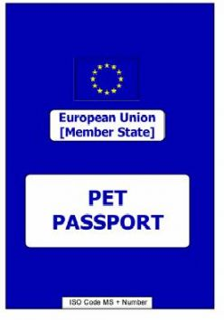
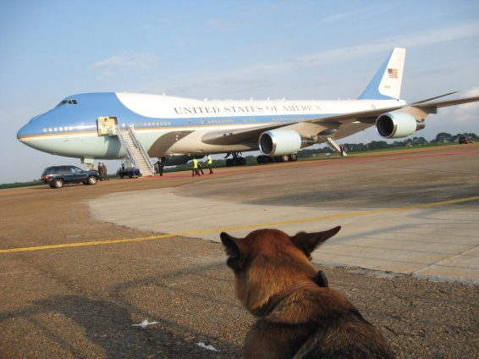
LEAVING ITALY
Get an EU Pet passport within 3-6 months of arrival of arrival/ adoption. Do not wait until its time to PCS!
PCSing from Naples requires 2-3 months prep and 6 months lead time for Japan and Hawaii. Japan has a 6 month quarantine period that can be started in Italy.
The AMC rotator's pet space availability is extremely limited. Combined weight limit for a pet and cage is 150 lbs (no exceptions or waivers).
Plan ahead and contact our office once you get orders

Slide 11
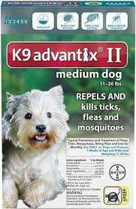
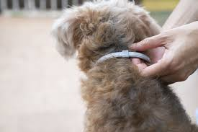
LEISHMANIASIS
Canine Leishmaniasis is a disease caused by sand-flies. Both pets and people can be infected. Most prevalent during hot months (APR- SEPT)
It causes skin issues, multiple organ failure, weight and muscle loss and inflammation
Endemic in here in Southern Italy (Naples) and Mediterranean
Infected animals may be refused return to some US states (state dependent)
Prevention: Seresto collar or Advantix

Slide 12
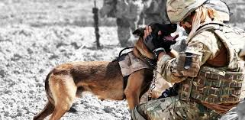
QUICK FACTS
We are not an emergency clinic
We do not see walk-in or same day appointments
We are not authorized to handle strays on base
If you are fostering, please make sure they receive ALL core vaccines and preventives. They can carry diseases that can cause your pets and family members to get sick!!!
We may close the clinic last minute Military Dog emergency
We are closed every Thursday and last working day of the month for inventory.

Slide 13
Checklist
Register your pet(s) at the Veterinary base clinic within 30 days
Find Italian vet clinic for Emergency and local Rx
Maintain annual rabies vaccinations during overseas tour
Get updated ID tags and update microchip with local contact
Register pet in ASL within 2 months of arrival
Obtain a pet passport within 6 months - 1 year of arrival/adoption or during the day of registration.
USE heartworm and flea/ tick preventative that will protect against sand flies and Leishmaniasis year round.
Find a boarding center or a reliable pet sitter.
Read the NSA Naples Pet Policy.
Understand and adhere to local Italian pet laws.

Slide 14

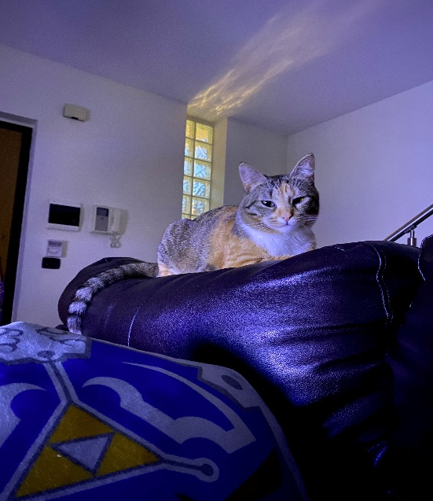
CONTACT INFO
QUESTIONS?
DSN: 629 – 7913
COM: +39 - 081 - 811 - 7913
usn.naples.navhospnaplesit.mbx.vet-clinic@mail.mil
(New VTF website coming soon)

